Slide 1



CropNexus
Climate-Resilient Agriculture: Predicting Crop Yields

Slide 2

IBM SkillsBuild for Adult Learners - Data Analytics
Data Analytics Internship Program 2024
Final Project Presentation
Project Name: CropNexus
Team Name: NEXUS
College Name: Acropolis Institute of Technology &
Research

Slide 3




Meet Our Team
Anusha Dubey
Himanshu Sopra
Nidhi Sharma
Surabhi Jaiswal

Slide 4
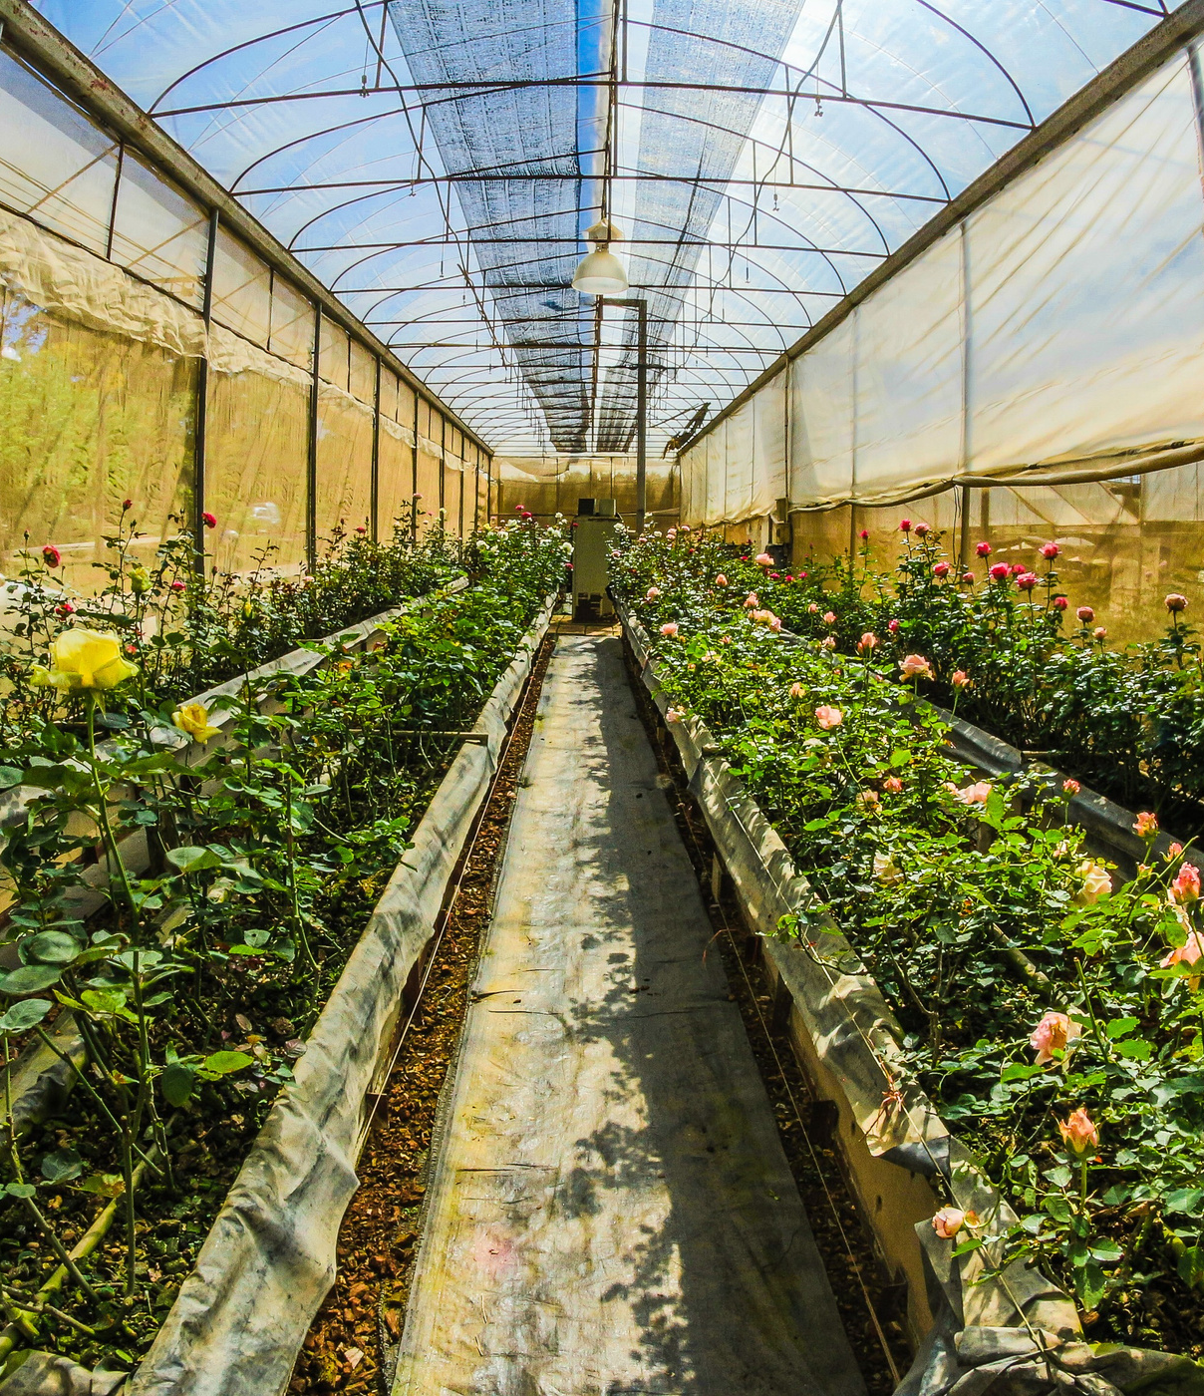
Overview
CropNexus harnesses the power of machine learning to forecast crop yields in a world of shifting climates. By transforming climate data into actionable insights, it empowers farmers and policymakers to navigate environmental challenges and secure a resilient future for agriculture.
CropNexus combines climate and crop yield data to offer actionable insights. It analyzes trends and simulates future conditions to help optimize farming, enhance food security, and promote sustainability.
With its focus on translating complex data into clear, practical recommendations, CropNexus stands at the forefront of climate-resilient agriculture, offering innovative solutions to navigate and thrive in a changing world.

Slide 5



OBJECTIVE
CropNexus seeks to unlock the future of agriculture by predicting how crop yields will respond to shifting climates. It aspires to empower farmers and policymakers with foresight and actionable data, enabling them to adapt practices, safeguard food security, and champion sustainable farming.
CropNexus is dedicated to transforming agricultural decision-making by forecasting crop yields across various climate scenarios. Its mission is to provide farmers and policymakers with innovative tools and insights to proactively adjust practices, enhance resilience, and foster sustainable food systems.
CropNexus aims to bridge the gap between climate science and agriculture by predicting crop yields under evolving climate conditions. It strives to offer forward-thinking solutions that enable proactive adjustments, bolster food security, and advance sustainable agricultural practices.

Slide 6

Problem Statement:
This project aims to develop a model to predict crop yields under different climate scenarios, aiding farmers and policymakers in optimizing practices for resilience and food security.
Significance of the Problem:
Food Security: Ensures stable food supplies.
Farmer Support: Helps adapt practices to mitigate climate impacts.
Policy Making: Informs agricultural and climate policies.
Sustainable Agriculture: Promotes resilient land use practices.
Relevant SDGs:
SDG 2: Zero Hunger
SDG 13: Climate Action
SDG 15: Life on Land
01
02
03

Slide 7

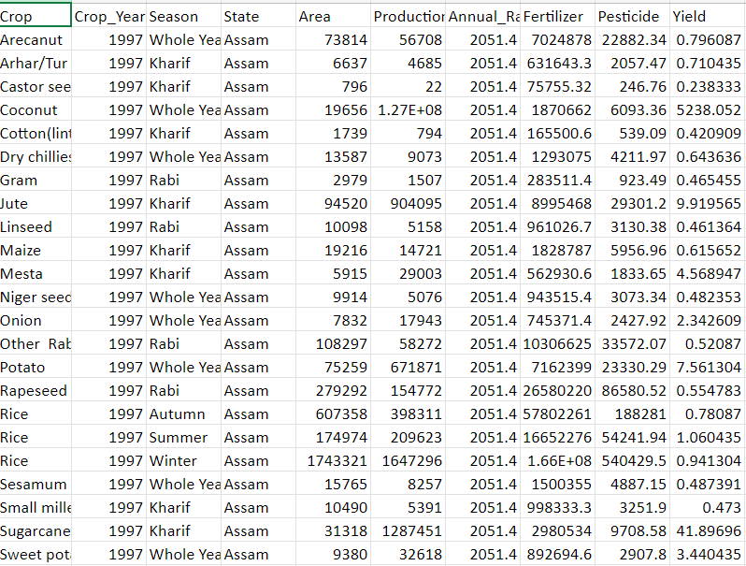
DATA COLLECTION
This dataset is curated from Kaggle, offering a wealth of agricultural insights.
The dataset, coverS crops in India from 1997 to 2020, includes 19,698 rows and 10 columns.
It focuses on predicting crop yields based on factors such as weather conditions, fertilizer, and pesticide use.
Each row provides detailed data for specific crops, offering insights for yield prediction and agricultural analysis.

Slide 8

Data Collection and Familiarization:
Collect and review historical crop yield, climate, soil, and management data.
Data Cleaning and Preprocessing:
Address missing data and normalize variables.
Statistics and Visualization:
Calculate statistics and visualize crop yield distributions.
Bivariate and Multivariate Analysis:
Explore relationships and interactions between crop yields and climate variables.
Spatial Analysis:
Analyze spatial patterns and time series trends in crop yields.

Slide 9
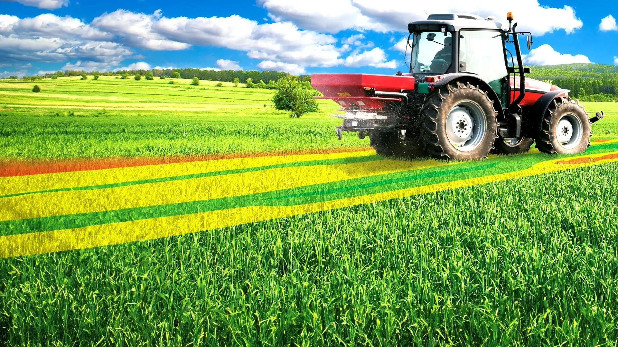



Technology stack

Slide 10
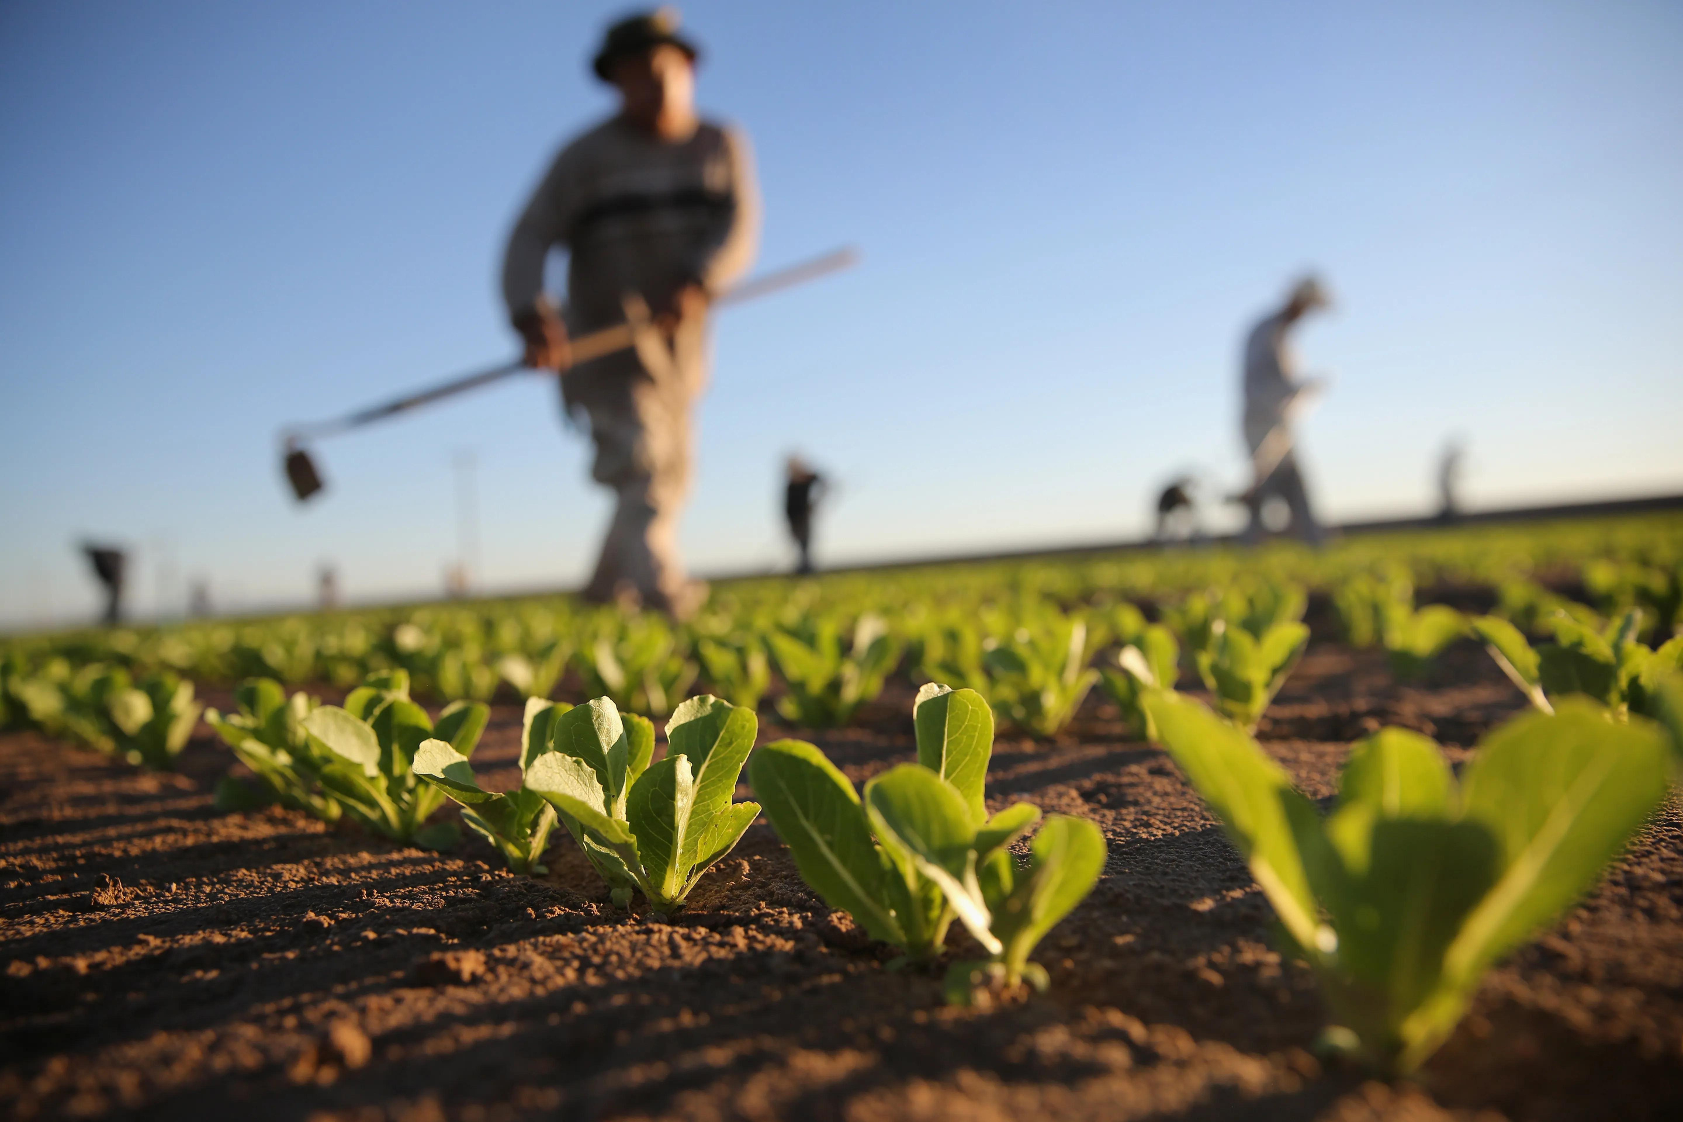

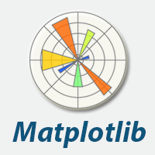


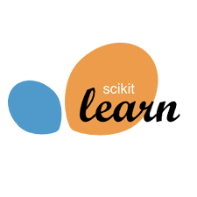

MODULES
NumPy is a fundamental Python library for numerical computing, providing support for arrays, matrices, and a wide range of mathematical functions to operate on them.
Seaborn is a Python data visualization library based on Matplotlib, providing a high-level interface for drawing attractive and informative statistical graphics.
Pandas is a powerful Python library for data manipulation and analysis, offering versatile data structures like Series and DataFrame
Matplotlib is a popular Python library for creating static, animated, and interactive visualizations in a variety of formats.
Scikit-learn is a widely-used Python library for machine learning, providing simple and efficient tools for data mining, data analysis, and modeling..

Slide 11


Key Findings
Visualizations and statistics reveal yield patterns and climate correlations.
Multivariate analysis shows complex interactions.
Spatial analysis identifies regional productivity trends.
Time series analysis tracks yield responses to climate changes.
Insights Derived
Forecasting and adaptation strategies are informed by climate impacts on yields.
Regional trends guide targeted agricultural interventions.
Anticipating future yield changes aids in policy and practice adjustments.

Slide 12

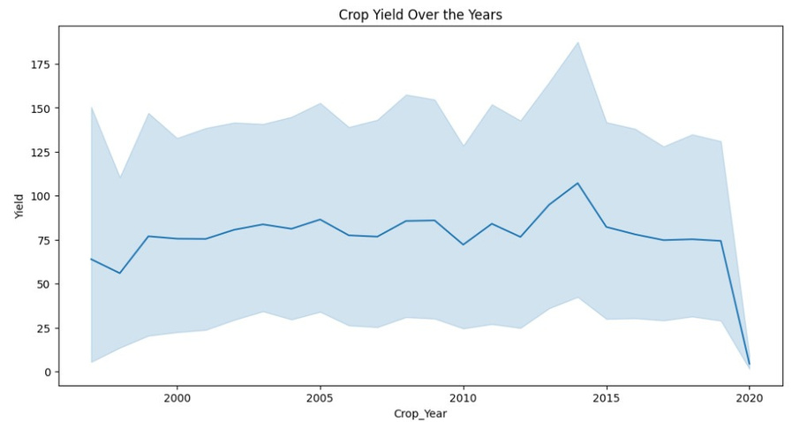
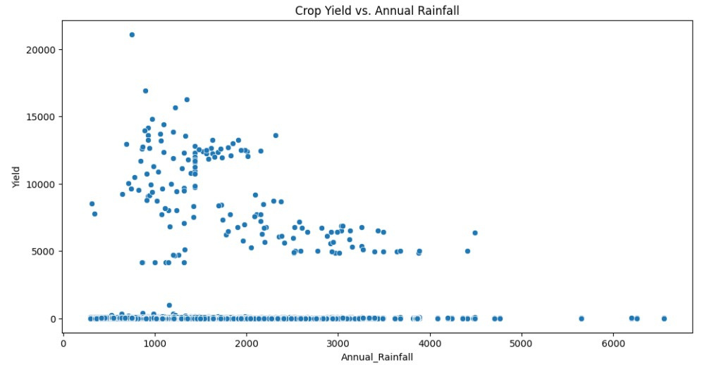
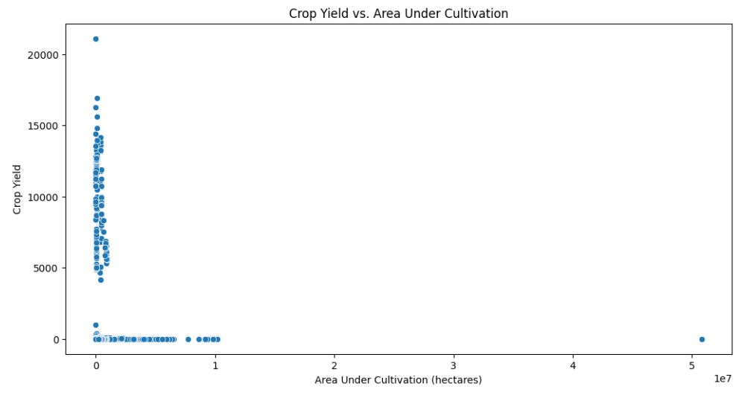
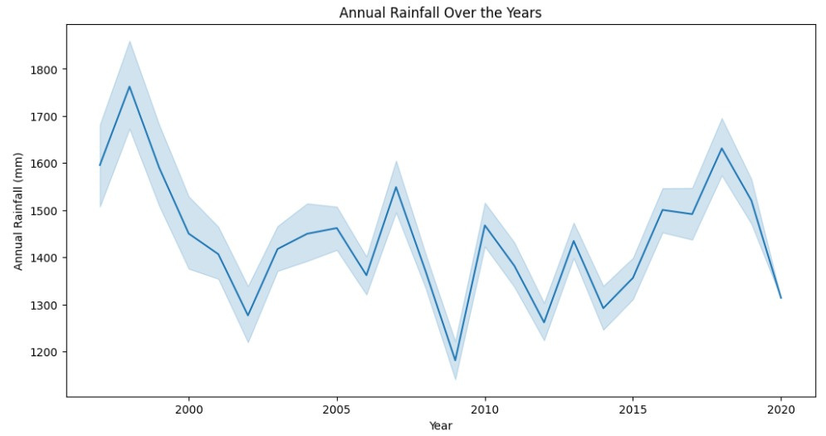
Visualizations

Slide 13
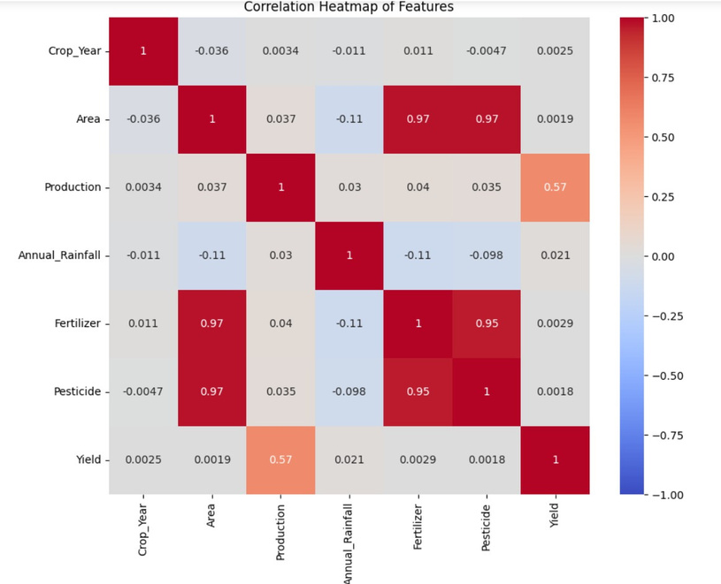
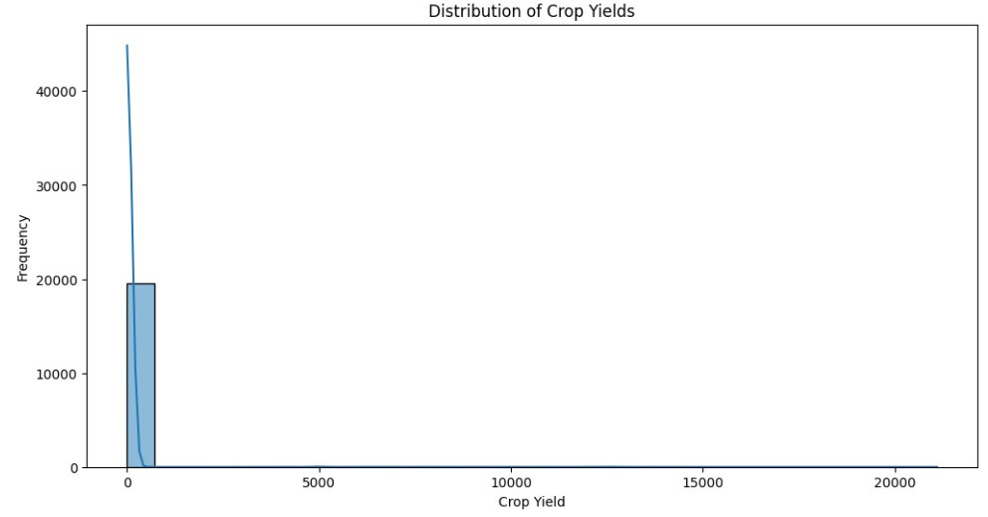
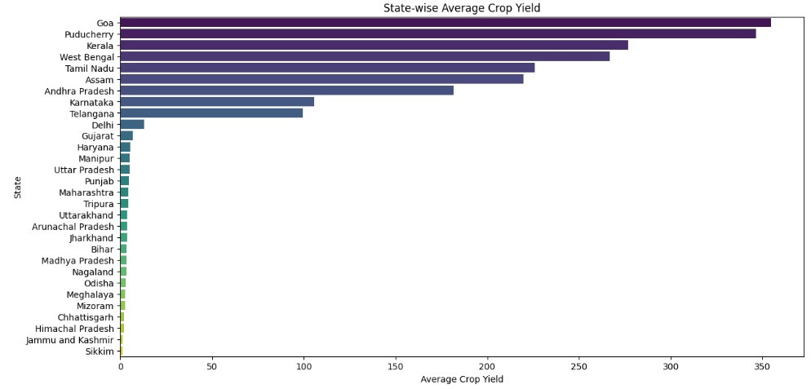
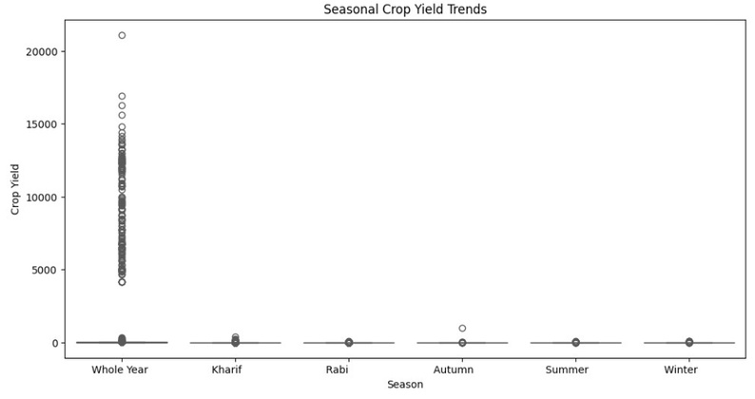
Visualizations

Slide 14
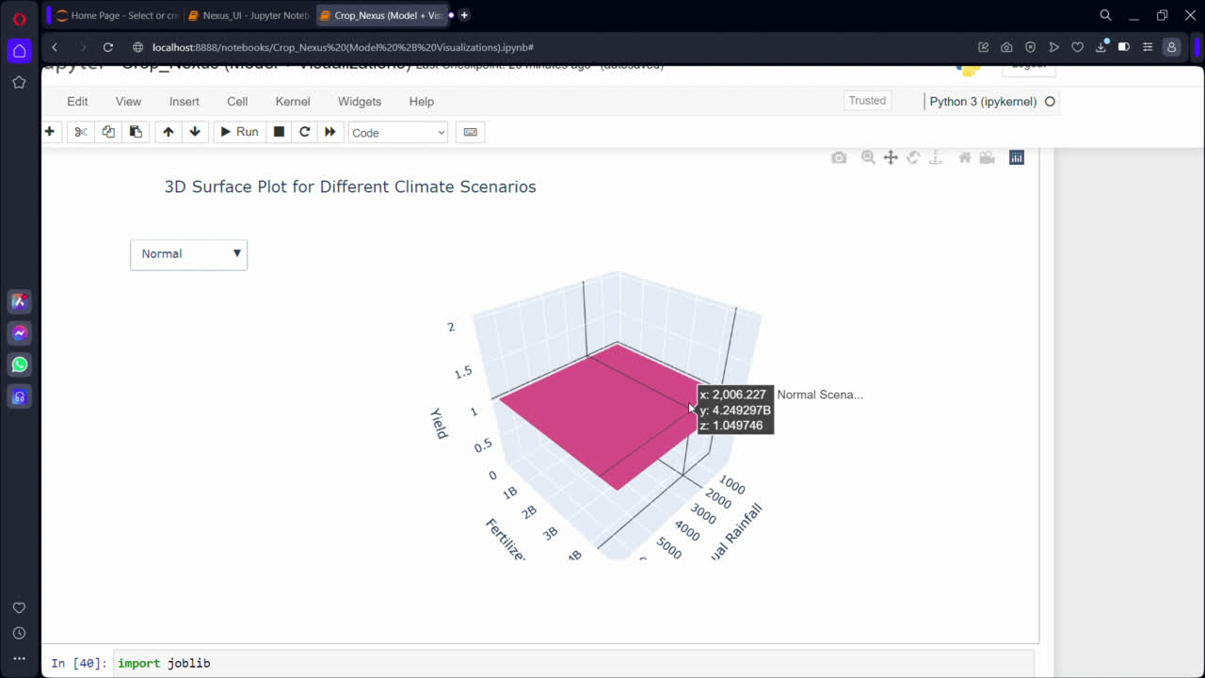

Slide 15
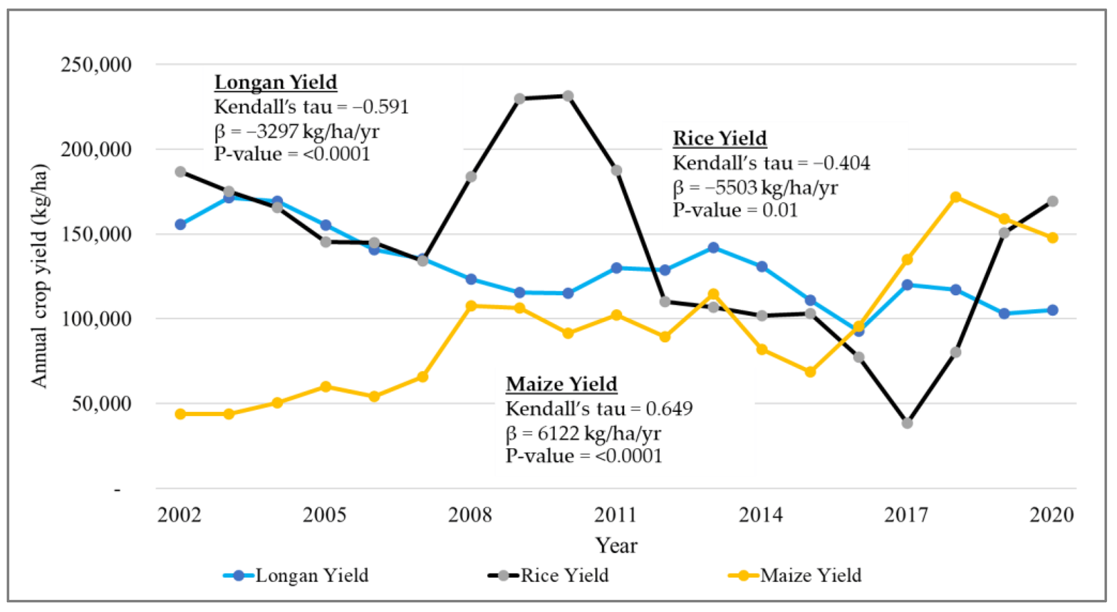
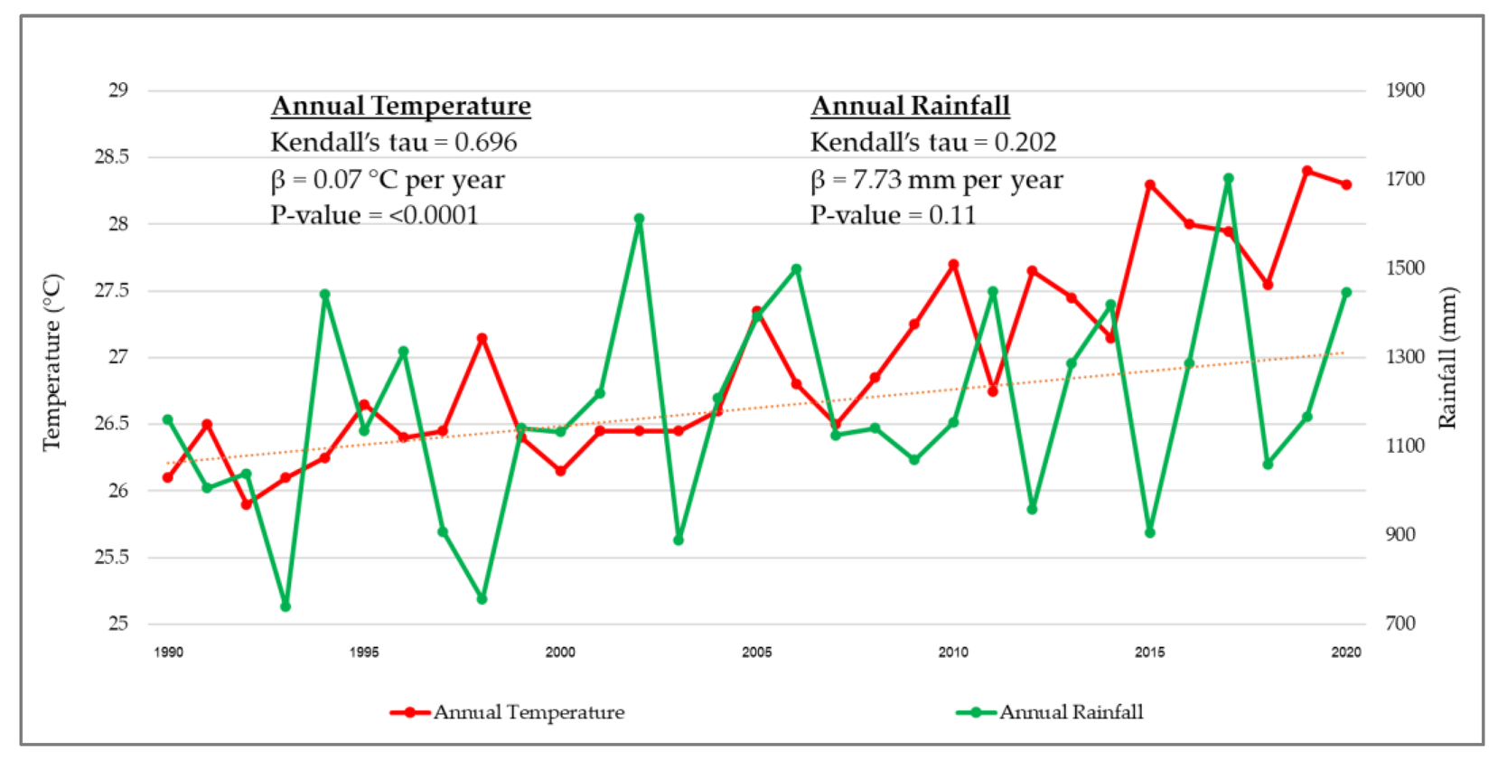
Fact | Figure
Number of Crops Studied | 50+ major crops including rice, wheat, maize, pulses, and oilseeds
Annual Crop Yield Variability | 10-20% variability in yields due to climate, soil, and management practices
Major Crop Growing Regions | 6 regions: North, South, East, West, Central, and Northeastern India
Top Crop Yields (Metric Tons per Hectare) | Rice: ~3.5-4.5, Wheat: ~3-3.5, Maize: ~2.5-3
Annual Average Crop Yield Growth Rate | 2-3% per year, varying by crop and region
Climate Impact on Yields | 5-15% potential yield loss due to climate change by 2050
Irrigation Coverage | ~50% of crop area is irrigated; varies by region
Key Crop Yield Data Sources | Indian Council of Agricultural Research (ICAR), Ministry of Agriculture, and state agricultural departments
Impact of Technology Adoption | 10-15% yield increase due to improved seeds, technology, and practices

Slide 16
Conclusion
Summary of Findings
Impact of Proposed Solution
The CropNexus project successfully leveraged advanced machine learning techniques to predict crop yields using a rich dataset spanning from 1997 to 2020. With 19,698 data entries and key features such as weather conditions, fertilizer, and pesticide use, the analysis provided detailed insights into how these factors influence crop productivity across multiple states in India. The predictive models generated actionable forecasts, revealing significant correlations between agronomic factors and yield outcomes.
Impact of Proposed Solution: The implementation of CropNexus delivers considerable benefits to both farmers and policymakers. By offering precise yield predictions under varying climate scenarios, it enables more informed decision-making, optimizing agricultural practices and improving food security. The project supports sustainable farming by highlighting best practices and recommending adjustments based on predictive insights, thereby fostering resilience in the face of climate change.
Future Work
Future efforts could focus on expanding the dataset to include more recent data and additional variables such as soil health and advanced agronomic practices. Enhancing model accuracy through the integration of real-time data and exploring the use of more sophisticated machine learning techniques could further refine predictions. Additionally, developing an interactive dashboard for users and exploring regional case studies could offer more targeted insights and practical recommendations for different agricultural zones.

Slide 17
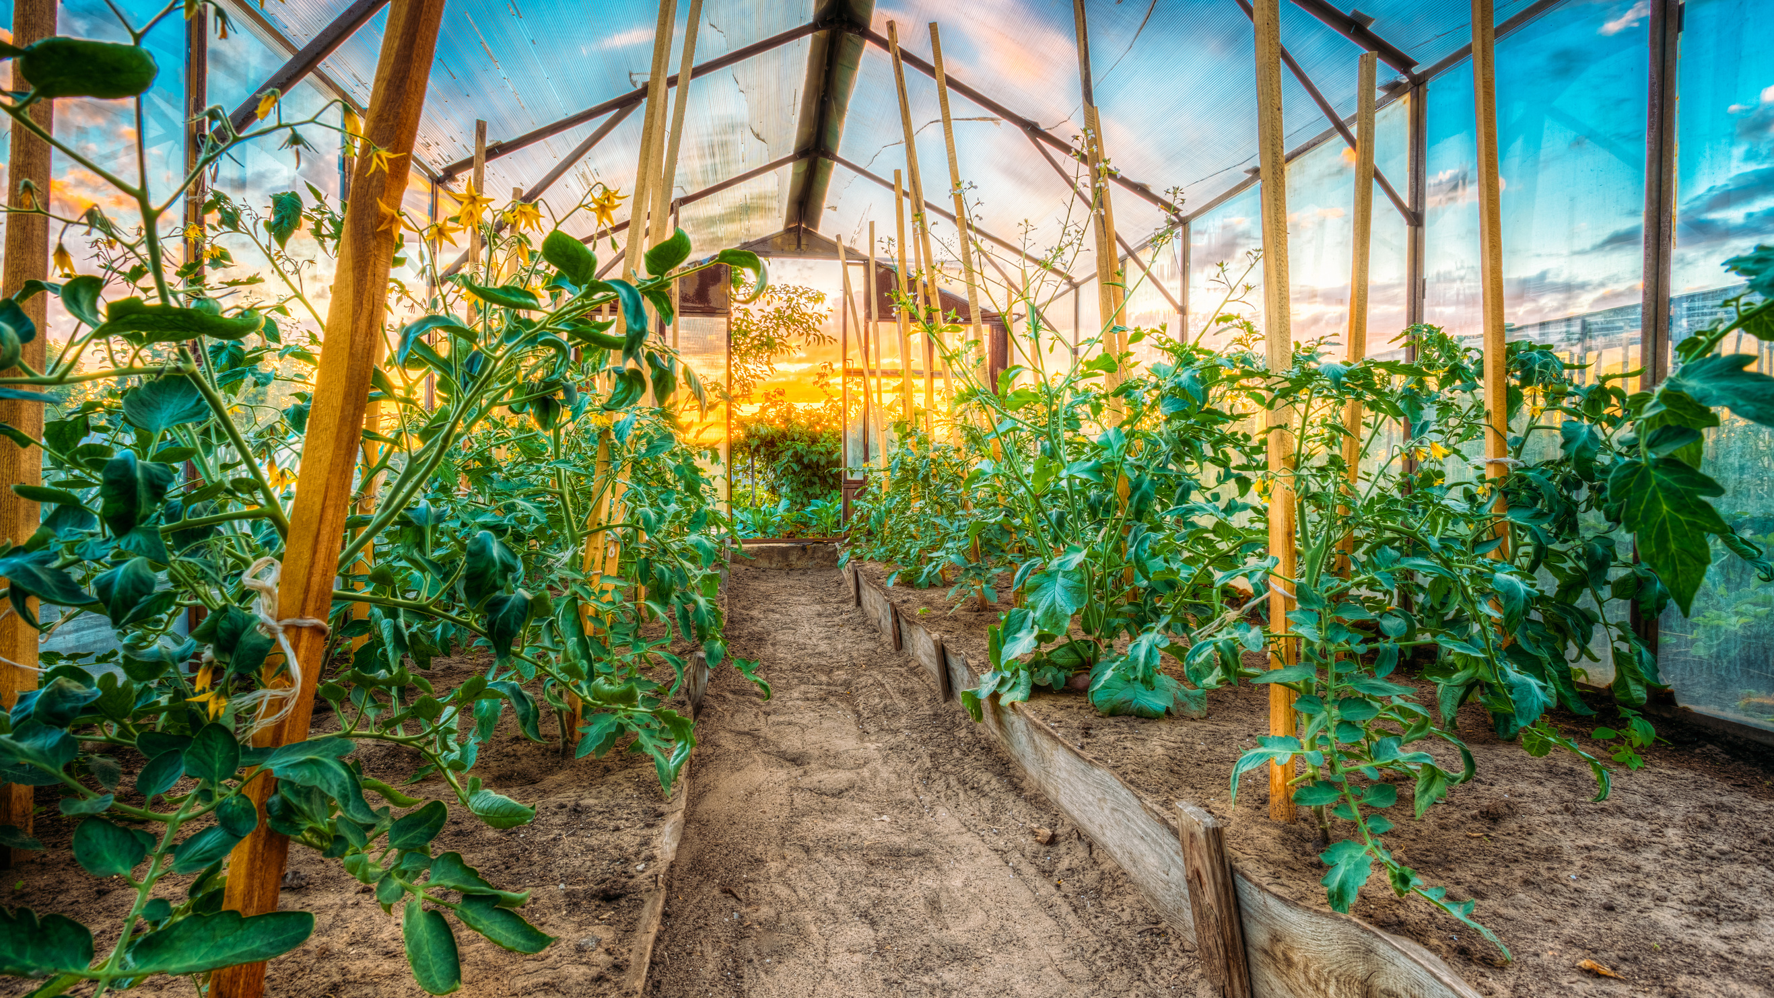
Thank You

